Slide 1
LIVE DATA COLLECTION AND AUDIENCE REACTION ANALYSIS
Group 2
NAMES | REG. NO
TURYA JOHN STEVEN | 2023-B071-21285
WALWASA NATHAN ABEL | 2023-B071-21203
BIRUNGI BRIDGET | 2023-B071-22674
SSEMANDA JONATHAN | 2023-B071-22335
NALULE CATHERINE | 2023-B071-22337
NSUBUGA NICHOLAS PAUL | 2023-B071-22173

Slide 2
OVERVIEW
Content (as a simple flowchart).
Data collection: Scraped 2,000 comments from the YouTube video using the apify youtube comment scraper.
Data Cleaning. Pre-processed text by removing stopwords, emojis, and punctuation using Python (NLTK, regex).
Feature engineering. Extracted the most frequent keywords using a Count Vectorizer.
Sentiment Analysis. Classified each comment as positive, negative, or neutral using TextBlob's polarity model.
Visualization. Generated plots and word clouds using Matplotlib and WordCloud to visualize findings.
Data source box.
Video: Trump (Mark Angel comedy) episode 203
Video URL: https://youtu.be/Z1yBM1mheU4
Total comments analyzed: 1,000

Slide 3
BUSINESS UNDERSTANDING
Why Analyze the Comments?
Gauge overall mood. Determine if the audience response is predominantly positive, negative or neutral.
Identify key topics. Discover the specific aspects of the video (characters, jokes, themes) that viewers are discussing.
Uncover response patterns. Find recurring themes to understand the video's impact and long-term appeal.
Actionable insights. Translate the data into strategic recommendations for future content and community engagement.

Slide 4
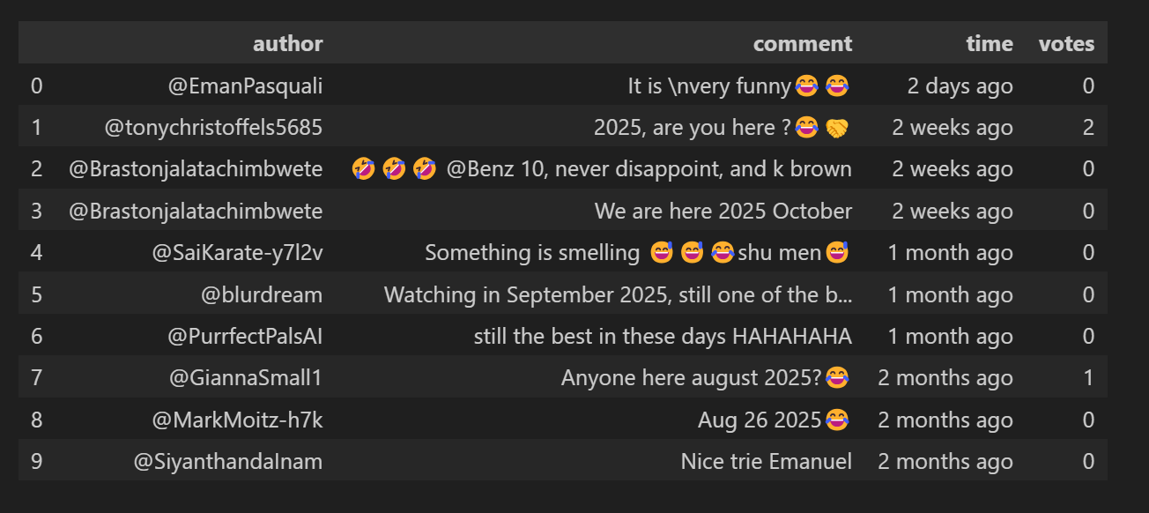
SAMPLE COMMENTS

Slide 5
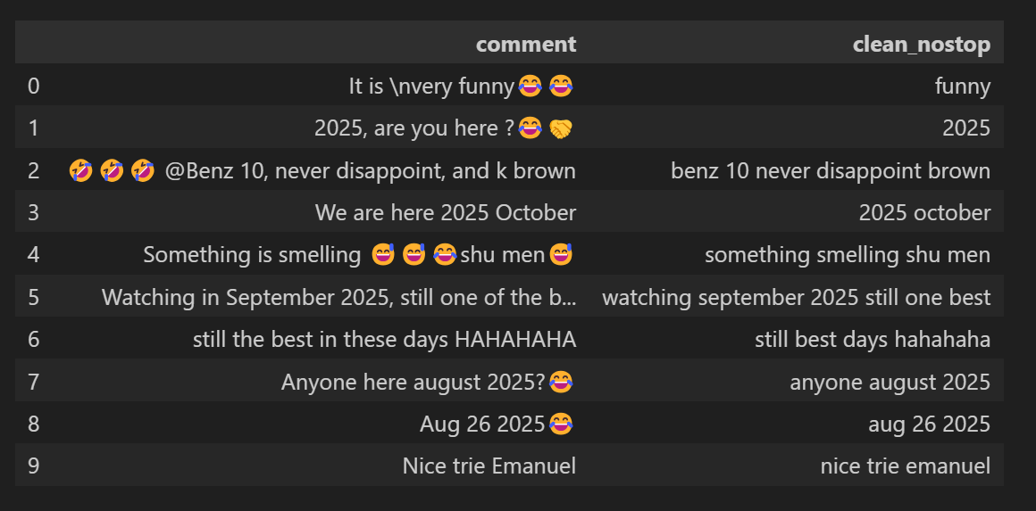
SAMPLE CLEANING

Slide 6
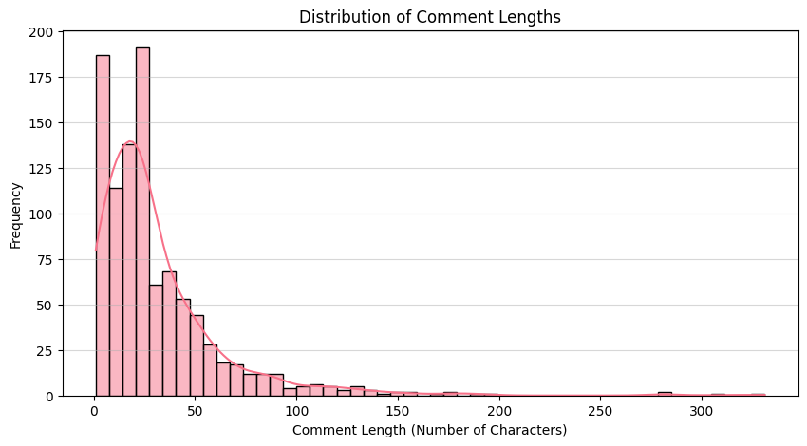
DISTRIBUTION OF COMMENT LENGTH

Slide 7
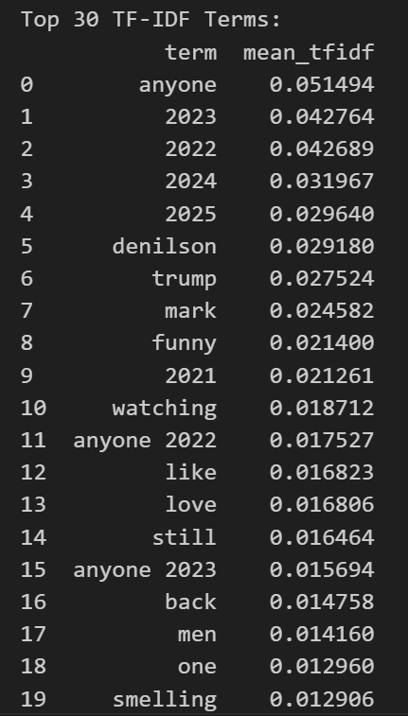
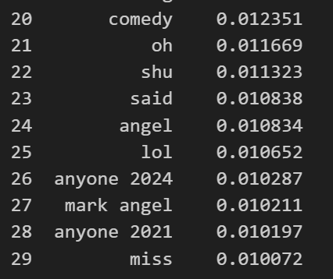
TOP 30 TF-IDF TERMS

Slide 8
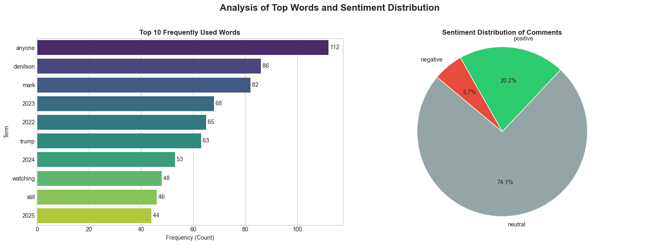
TOP 10 WORDS AND SENTIMENT DISTRIBUTION

Slide 9
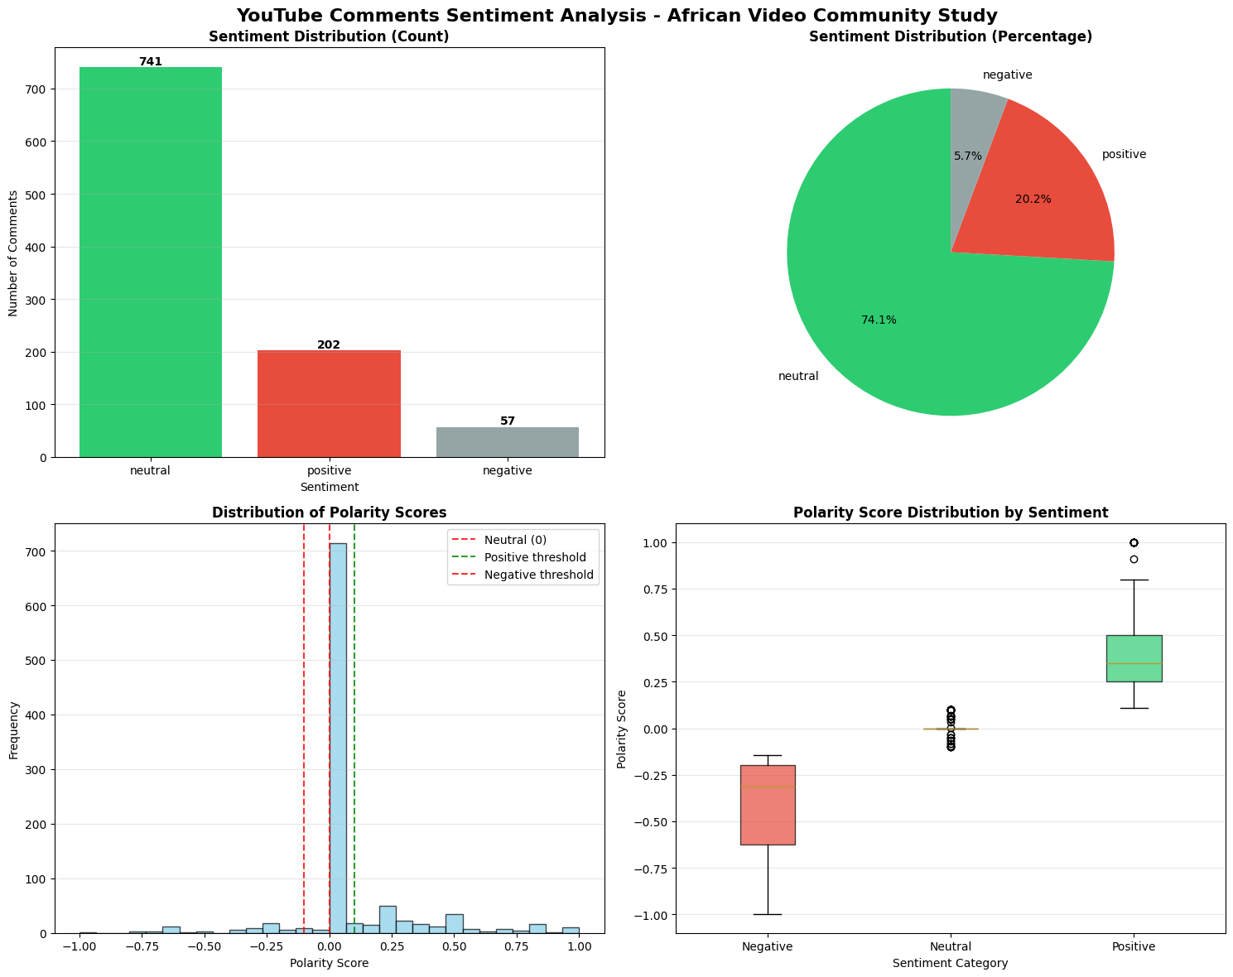
SENTIMENT ANALYSIS

Slide 10
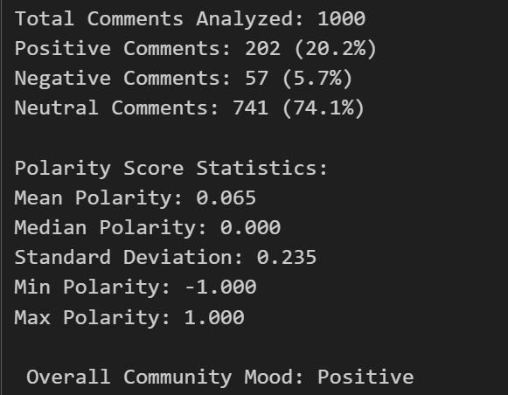
Detailed Sentiment Statistics

Slide 11
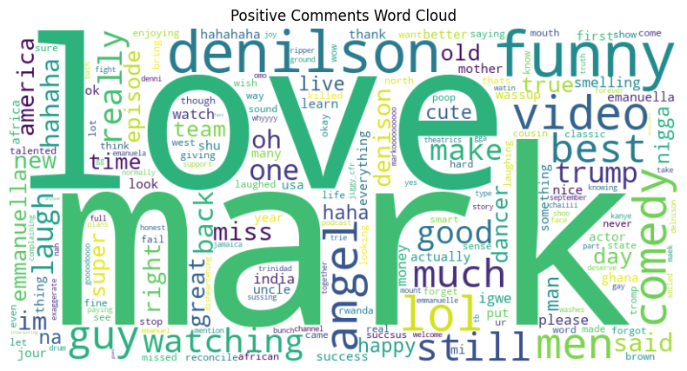
WORD CLOUD (POSITIVE)

Slide 12
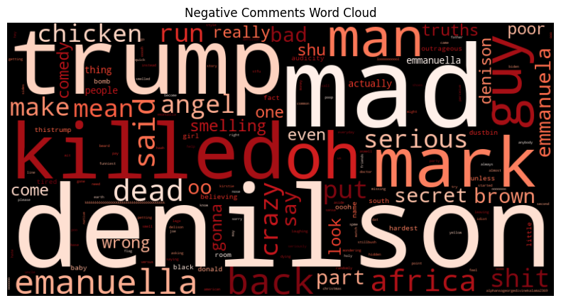
WORD CLOUD (NEGATIVE)

Slide 13
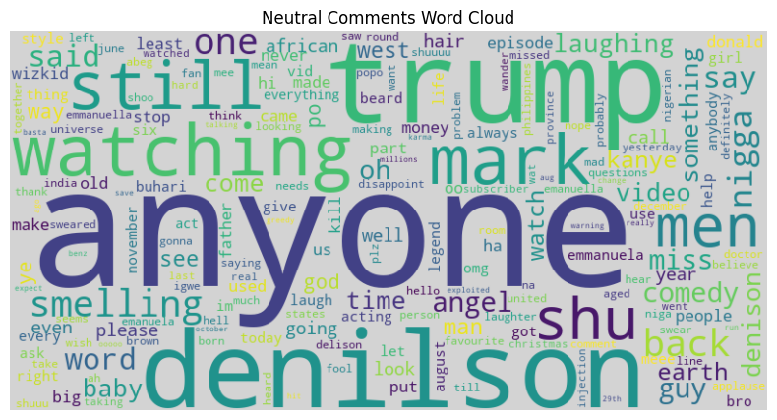
WORD CLOUD (NEUTRAL)

Slide 14
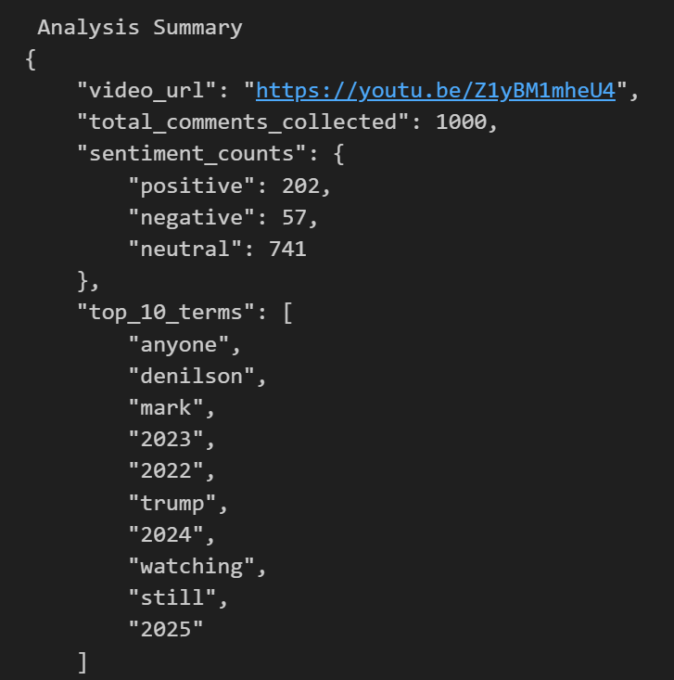
Summary of the analysis

Slide 15
Interpretation: Emotional tone and response patterns
1. The emotional tone is positive and engaged.
The mean polarity score of +0.065 confirms a positive skew. The community is not only just watching, they are actively expressing enjoyment.
2. The content is timeless.
The most common response pattern is viewers sharing the year they are watching ("anyone 2025"). This is a powerful indicator of content that remains relevant and re-watchable over time.
3. Strong brand and character loyalty.
Frequent mentions of "Mark Angel" and "Denilson" show that the audience isn't just watching a random video, they are following a brand and its beloved characters.
4. Humor is quote-worthy.
The analysis of top terms shows that viewers love to repeat memorable lines from the skit, which deepens engagement and creates a shared experience.

